Slide 1
Emotion detection on news
HLT 23/24
LUCIA C. PASSARO

Slide 2



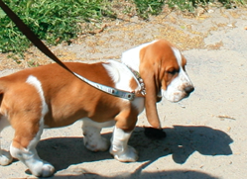

Meet The Team
Alberte
Marco
Dragoș
Oleksiy
Erasmus
AI Student
Erasmus
AI Student

Slide 3

Agenda
Introduction
Our Approach
State of the Art
Data
Architecture
Models
Evaluation
Conclusion
Notes:
%fix

Slide 4

Introduction
Emotion detection on News dataset
Enhances news recommendation system
Considers interests and emotions

Slide 5

Why detect emotions?
Emotion detection personalizes interactions
Benefit many domains and industries

Slide 6

Our Approach
Utilize supervised learning
Create system for uncovering emotions in news articles
Train and test on Forex News Annotated Dataset¹
Refine model for accurate emotional identification
https://zenodo.org/records/7976208

Slide 7

State of the Art
Deep learning models
  RNN
  CNN
  Transformer architectures
Notes:
The state-of-the-art (SOTA) for emotion detection often involves deep learning models, particularly those based on recurrent neural networks (RNNs), convolutional neural networks (CNNs), or transformer architectures. These models are capable of capturing complex patterns and dependencies in textual data, enabling them to accurately detect emotions expressed in text.
One of the commonly used SOTA models for emotion detection is BERT (Bidirectional Encoder Representations from Transformers) and its variants. By pre-training on large corpora of text data and fine-tuning on emotion detection datasets, BERT-based models can effectively capture contextual information and semantic relationships to infer the emotional content of text.

Slide 8

Annotated Dataset
The dataset comprises 2,291 unique news headlines
Each headline sentiment is manually annotated
It uses three categories for annotation: positive, negative, and neutral
published_at | ticker | true_sentiment | title | author | url | source | text
2023-01-12 07:47:00 | EURCHF | Positive | Euro to benefit from the ECBs pronounced hawkish determination – Commerzbank | FXStreet Insights Team | https://www.fxstreet.com/news/… | FX Street | The Euro was able to appreciate particularly significantly…

Slide 9
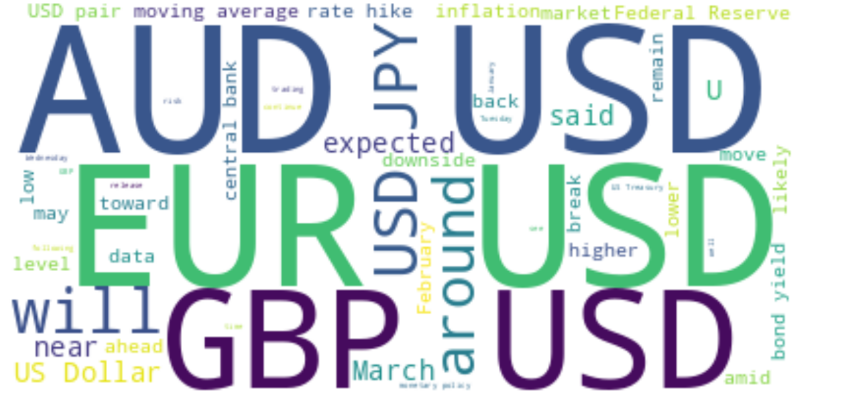
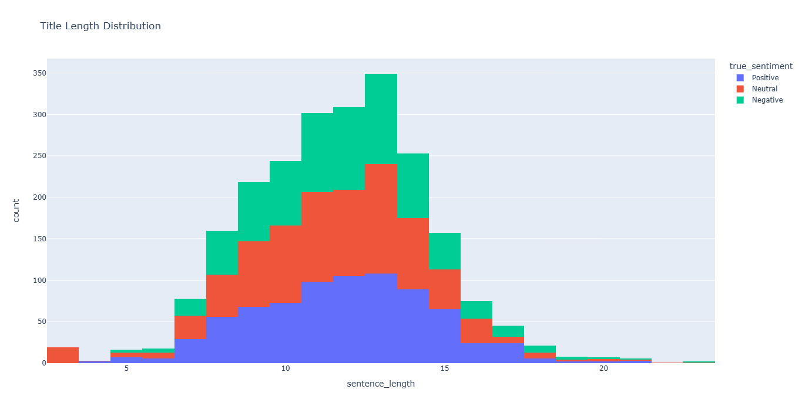
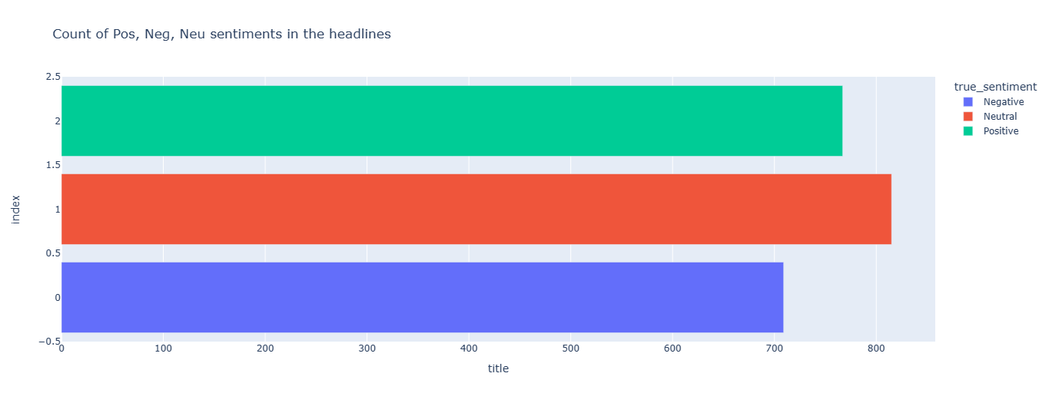
Data Analysis
Plenty of terms that does not help the sentiment analysis
More neutral articles
Headlines of articles are relative small

Slide 10
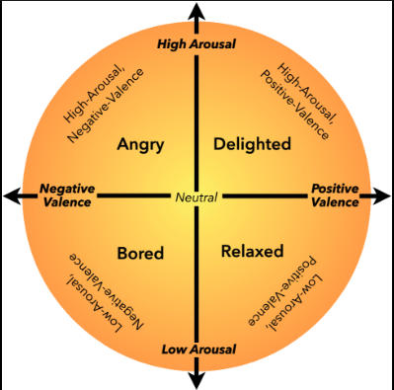
Emotion Analysis
NRC VAD lexicon
Valence: pleasantness of the stimulus
Arousal: level of alertness, activeness, or energy provoked by the stimulus
Dominance: degree of control exerted by the stimulus
Enhances understanding of emotional nuances within content
Notes:
Emotion analysis plays a crucial role in understanding the affective content of text data. It involves quantifying the emotional aspects present in the text, which can provide valuable insights into the overall sentiment, tone, and mood delivered by the content.
In our approach, we utilized the NRC VAD Lexicon, a lexicon that assigns valence, arousal, and dominance scores to words in the English language. These scores represent different dimensions of emotions. These can be defined as;
-Valence refers to the pleasantness of the stimulus,
-arousal indicates the level of alertness, activeness, or energy provoked by the stimulus and
-dominance represents the degree of control or dominance exerted by the stimulus or the emotion.
For example, a news title containing words with high valence and arousal scores may indicate a positive and exciting event, while a title with low valence and arousal scores may deliver a more negative or subdued tone. Similarly, dominance scores can provide insights into the assertiveness or passivity of the emotions delivered in the text.(maybe too extensive, delete?)
Deploying the NRC VAD Lexicon for emotion analysis in news articles enhances our understanding of the emotional nuances within the content.

Slide 11
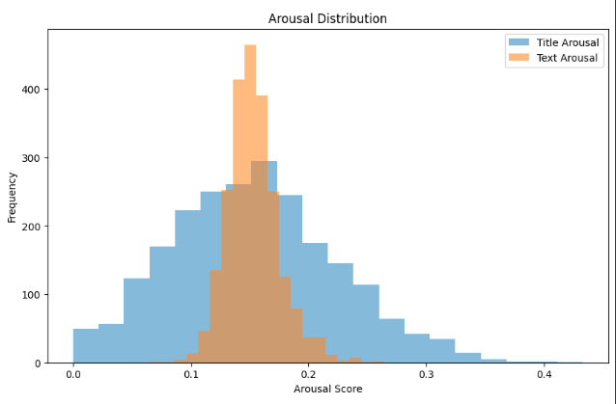
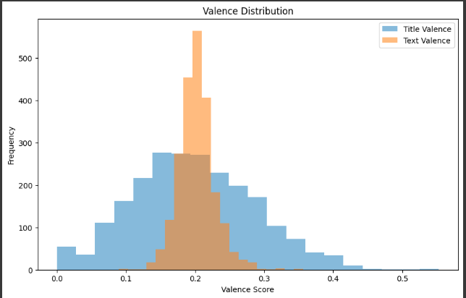
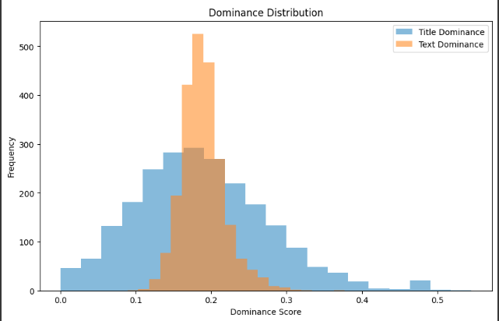
Emotion Analysis
Notes:
From the emotion analysis, iit became clear that titles are more effective to utilize than the text as the representation is much more evenly distributed, hence the remainder of the project will be conducted on headlines exclusively.

Slide 12
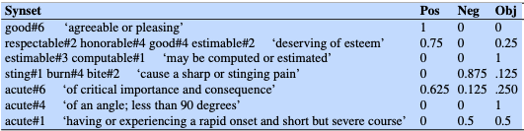
Emotion Analysis
SentiWordNet lexicon
Pos: the positivity score of a synset.
Neg:, the negativity score of a synset.
Obj:, the objectivity score of a synset (calculated as 1 - (PosScore + NegScore))
Provides nuanced analysis of sentiment at the word level
Notes:
An extension of this algorithm assigns polarity to WordNet senses, called SentiSentiWordNet WordNet (Baccianella et al., 2010). Fig. 25.8 shows some examples.
Examples from SentiWordNet 3.0 (Baccianella et al., 2010). Note the differences between senses of homonymous words: estimable#3 is purely objective, while estimable#2 is positive; acute can be positive (acute#6), negative (acute#1), or neutral (acute #4). In this algorithm, polarity is assigned to entire synsets rather than words. A positive lexicon is built from all the synsets associated with 7 positive words, and a negative lexicon from synsets associated with 7 negative words. A classifier is then trained from this data to take a WordNet gloss and decide if the sense being defined is positive, negative or neutral. A further step (involving a random-walk algorithm) assigns a score to each WordNet synset for its degree of positivity, negativity, and neutrality.
In addition to using the NRC VAD lexicon, we also employed SentiWordNet. SentiWordNet is an enhanced lexical resource explicitly designed for opinion mining. It extends WordNet, a lexical database for the English language, by associating each synset with sentiment scores
The emotion analysis additionally consists of utilizing the SentiWordNet, assigning to each synset of WordNet three sentiment scores: positivity, negativity, objectivity.
This allows for a nuanced analysis of sentiment at the word level, which can then be aggregated to provide an overall sentiment score for longer SentiWordNet 3.0.
For our analysis, we used SentiWordNet to calculate sentiment scores for each news headline.
The dual approach of using both NRC VAD and SentiWordNet, provides a comprehensive analysis of the emotional and sentiment dimensions of the news headlines. It allows us to capture both the specific emotional nuances and the general sentiment orientation, providing rich insights into the affective content of financial news.

Slide 13
Architecture
Traditional Machine Learning models:
Naive Bayes
  Predictions based on Bag of Words
  Independency assumption
Conditional Random Field
  Maximize local feature functions
Multi-Layer Perceptron
  Input embedded with sent2vec
  One hidden layer + ReLU activation
Notes:
Since then, we experimented with additional models, Llama-3-8b and Phi-3, with Llama-3-8b outperforming all our other models and thus selected as our chosen model for the project.
Among all the preprocessing techniques we tested, the only one that improved the results was normalizing the text by converting all characters to lowercase. We noticed a significant improvement in performance when we included the normalized lexicon scores for each headline in the prompt. We utilized the sum of NRC VAD and SentiWordNet lexicons scores for each word present, and subsequently normalized the values for each lexicon.
(maybe add visualisation? maybe add phi-3?)

Slide 14
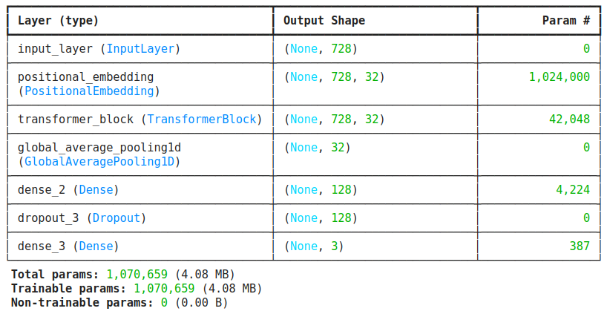
Architecture
Advanced Machine Learning models:
Custom Transformer Encoder
  Self-attention mechanisms to process input sequences
Pretrained Models
  Llama-3
    8B parameters, SoTA
  Phi-3 Mini
    3.8B parameters, SoTA
  Both instruction tuned
Notes:
We experimented with the models that are based on deep learning architectures. They have demonstrated significant improvements in performance for complex task such as sentiment analysis. These models can automatically learn feature representation from raw data. In our study, we focused on transformer-based due to their state-of-the art performance in NLP tasks.
Custom Transformer Encoder
We initially designed a custom transformer encoder to explore its capabilities. This model utilizes self-attention mechanisms to process input sequences, allowing it to capture long-range dependencies in the text. The architecture can be seen in the figure
To the standard encoder's output, we incorporated a \texttt{GlobalAveragePooling1D} layer to decrease dimensionality. Initially, we appended only one \texttt{Dense} layer with $3$ units, but upon experimentation, we added one more. Regrettably, this adjustment didn't enhance the model's stability; in fact, it likely exacerbated the issue. See figure \ref{fig:Tb-loss} and \ref{fig:Tb-eval} for visualizations of the performance during training and evaluation
Pre-trained Models}
Llama-3-8b stands as the next-generation state-of-the-art open-source large language model developed by Meta, pre-trained on over $15$ trillion tokens gathered from publicly accessible sources. However, the chosen model is more than just that. It underwent instruction fine-tuning with supervised fine-tuning (SFT), rejection sampling, proximal policy optimization (PPO), and direct preference optimization (DPO). The model's backbone is the standard decoder-only transformer. It employs a tokenizer with a vocabulary of $128$K tokens to encode language. To streamline our task, we selected the Llama-3-8b model, which was trained on instructional data. To assess the sentiment analysis capabilities of Llama-3-8b, we initially tested it through a series of experiments using the zero-shot approach. This enabled us to directly assess the inherent capabilities of the LLlama-3-8b model in sentiment analysis, without relying on any additional information from our dataset.
Phi-3 Mini is a 3.8B parameters, lightweight, state-of-the-art open model trained with the Phi-3 datasets that includes both synthetic data and the filtered publicly available websites data with a focus on high-quality and reasoning dense properties. The model has underwent a post-training process that incorporates both supervised fine-tuning and direct preference optimization for the instruction following and safety measures. We placed the two models under the same conditions as previously mentioned, with the exception of differing hyperparameters. Spoiler: this model performed worse than Llama-3.
The model has underwent a post-training process that incorporates both supervised fine-tuning and direct preference optimization to ensure precise instruction adherence

Slide 15
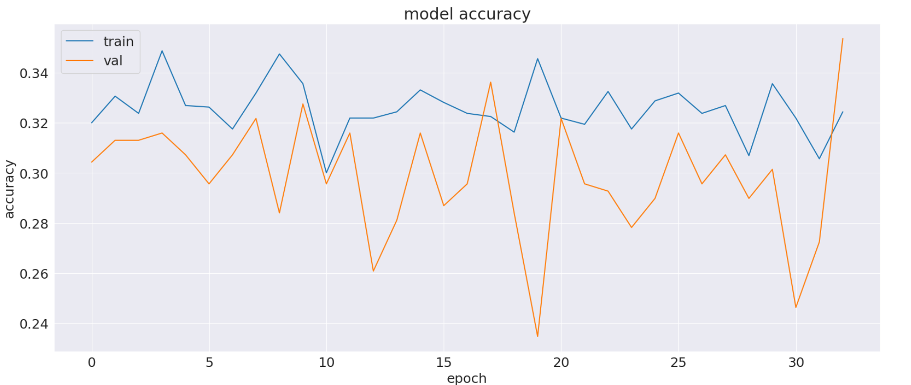
Models
TransformerBlock (encoder):
  Preprocessing:truncation, padding and tokenization with pre-trained LLama tokenizer
  Up to 80M trainable parameters by increasing the size of different layer dimensions
  The bigger was the less epoch we used, because of the computation limitation

Slide 16
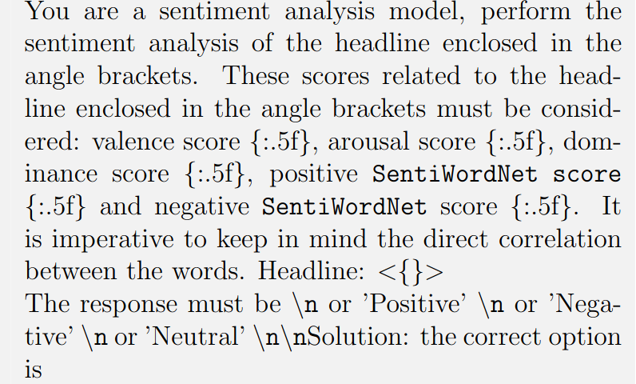
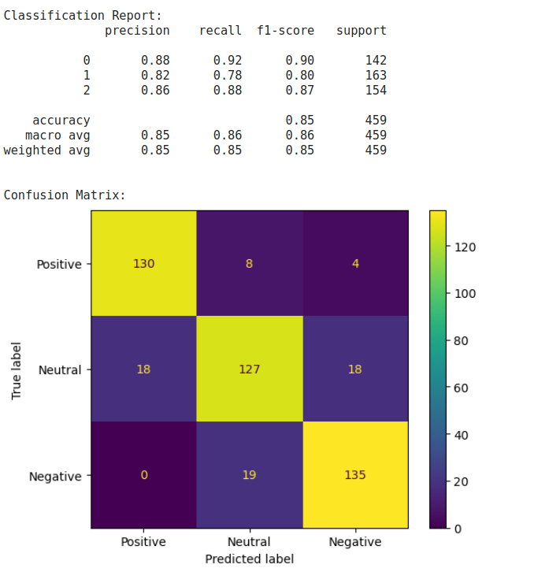
Models
Llama-3-8b
  Used news’ titles
  Lowercasing characters
  With NRC VAD & SentiWordNet and without
  Trainable params: 83M, 1%
Notes:
Since then, we experimented with additional models, Llama-3-8b and Phi-3, with Llama-3-8b outperforming all our other models and thus selected as our chosen model for the project.
Among all the preprocessing techniques we tested, the only one that improved the results was normalizing the text by converting all characters to lowercase. We noticed a significant improvement in performance when we included the normalized lexicon scores for each headline in the prompt. We utilized the sum of NRC VAD and SentiWordNet lexicons scores for each word present, and subsequently normalized the values for each lexicon.
(maybe add visualisation? maybe add phi-3?)

Slide 17
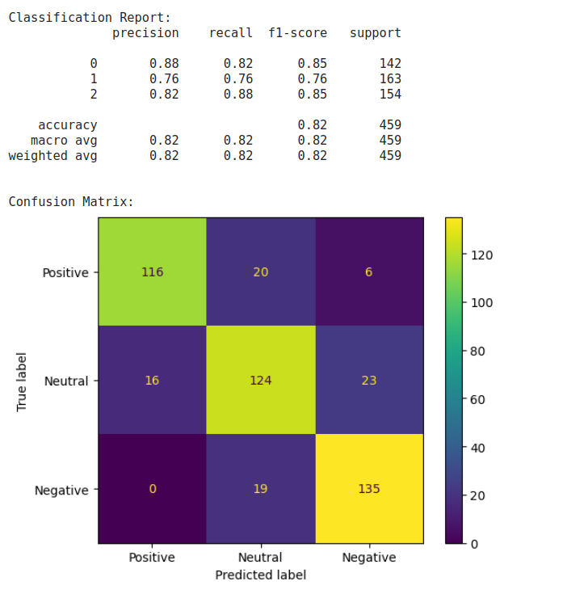
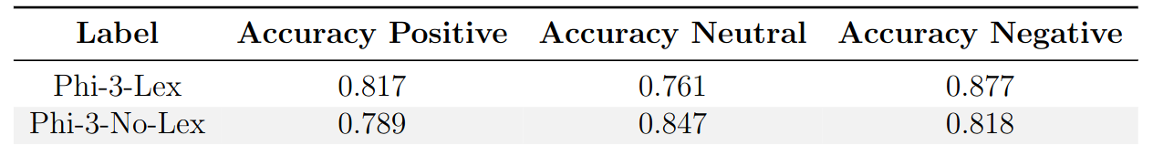
Models
Phi-3
  Same preprocessing and prompt as Llama-3
  Different hyperparameters
  Both fine-tuned with LoRa
  Trainable params: 119M, 3%
  Performed better without lexicons, but …

Slide 18
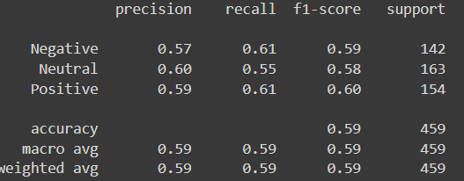
Models
Multi-Layer Perceptron
  Used news’ titles
  Removed some stopwords
  Sent2Vec
Notes:
One of the model studied for this task is a Multi-Layer Perceptron with 1 hidden layer with 80 neurons. We used the news titles and true sentiment from our dataset to train this model and we vectorized these sentences using the Vectorizer provided by sent2vec module, which uses a pre-trained Bert model. In order to obtain these result we removed some stopwords such as ‘the’ ‘and’ ‘to’ ‘in’. The dataset was splitted in this way: 70% of data used for the training and 30% for testing. For the development set the sklearn.fit function uses the 10% of the training data for the evaluation.

Slide 19
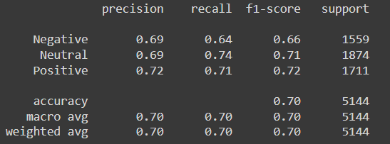
Models
Conditional Random Field
  Preprocessing: lemmatization, part-of-speech tag
  Feature functions: 33
  model size: 455008 byte
Notes:
Conditional Random Field: undirected graphical models that represent the conditional probability of a certain label sequence, Y, given a sequence of observations X
class TransformerBlock(layers.Layer):
def __init__(self, embed_dim, num_heads, ff_dim, rate=0.1):
super().__init__()
self.att = layers.MultiHeadAttention(num_heads=num_heads, key_dim=embed_dim)
self.ffn = keras.Sequential(
[layers.Dense(ff_dim, activation="sigmoid"), layers.Dense(embed_dim),]
)
self.layernorm1 = layers.LayerNormalization(epsilon=1e-9)
self.layernorm2 = layers.LayerNormalization(epsilon=1e-9)
self.dropout1 = layers.Dropout(rate)
self.dropout2 = layers.Dropout(rate)
def call(self, inputs):
attn_output = self.att(inputs, inputs)
attn_output = self.dropout1(attn_output)
out1 = self.layernorm1(inputs + attn_output)
ffn_output = self.ffn(out1)
ffn_output = self.dropout2(ffn_output)
return self.layernorm2(out1 + ffn_output)

Slide 20
Models
Positive label:
K-Fold results with 95% CI
Precision | 0.608 ±0.0603
Recall | 0.676 ±0.0258
F1 score | 0.642 ±0.0382
Macro-PRF | 0.626 ±0.0317
Naive Bayes
  Used only occurrences
  Applied “tickers” column to the input (making the assumption of independency):

Slide 21
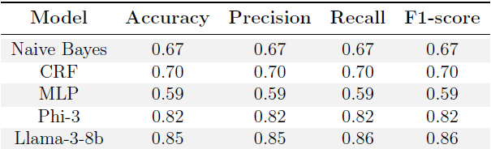
Evaluation - Our approach
Notes:
We assessed the performance of Llama-3-8b (and phi-3..) and compared against the SotA.
Llama-3-8b performs very well overall, with high recall particularly noted for negative sentiments. However, it encounters challenges in correctly identifying neutral sentiments.
Our referenced paper Transforming sentiment analysis in the financial domain with ChatGPT, has conducted experiments with ChatGPT-3.5, one similar to ours is GPT-P3. The second table shows a comparison of the results obtained by our best models and those obtained by the authors.
It emerges that the new pre-trained models excel in identifying sentiment in headlines, particularly Llama-3-8b, which demonstrates very stable evaluations and consistently high scores across the board. It's important to consider that the lexicon values played a crucial role in improving the results.

Slide 22
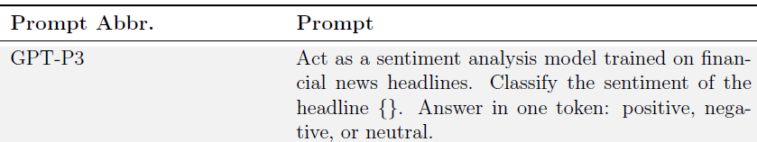
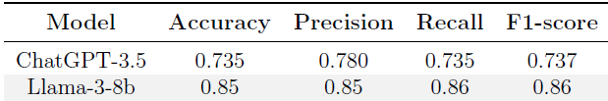
Evaluation - SOTA comparison
Notes:
We assessed the performance of Llama-3-8b (and phi-3..) and compared against the SotA.
Llama-3-8b performs very well overall, with high recall particularly noted for negative sentiments. However, it encounters challenges in correctly identifying neutral sentiments.
Our referenced paper Transforming sentiment analysis in the financial domain with ChatGPT, has conducted experiments with ChatGPT-3.5, one similar to ours is GPT-P3. The second table shows a comparison of the results obtained by our best models and those obtained by the authors.
It emerges that the new pre-trained models excel in identifying sentiment in headlines, particularly Llama-3-8b, which demonstrates very stable evaluations and consistently high scores across the board. It's important to consider that the lexicon values played a crucial role in improving the results.

Slide 23

What lies ahead?
Incorporating project with RecSys
Enlarging project
Notes:
Our exploration into the world of text-based emotion detection, TBED, within news sentiment, has served as a valuable tool for enhancing understanding; additionally considering the underlying challenges faced. By utilizing a range of machine learning models, we have achieved notable steps in the underlying emotional nuances within news content.
Moving forward, there exists a multitude of opportunities for further refinement and expansion. The integration of our TBED model into recommendation systems is one of them. By infusing personalized suggestions with a nuanced understanding of user sentiment, we can elevate the overall experience, leading to deeper engagement and satisfaction.
Considering enlarging the data in order to obtain better result would also suffice as another expansion of our project.
In conclusion, the journey has just begun, this project is merely a stepping stone towards a future where technology encompasses more than just. Through continued collaboration, innovation, and reflection, we can navigate toward a more informed, empathetic, and inclusive society; a world where TBED succeeds with 100\% accuracy.

Slide 24
Thanks for listening!
Have a question?
A.howitz@studenti.unipi.it

